Slide 1

Client to Client Chat System
CS 744
Avais Ahmad (173050043)
Abhijit Patil (173050085)
Under Guidance of:-
Prof. Mythili Vutukuru

Slide 2
Agenda
Problem Statement
Overview
Architecture Diagram
Performance
Optimization
Conclusion

Slide 3
Problem Statement
Interactive Chat system
Client Authentication via Multi-threaded Multi-tier Server
Multiple User handling server

Slide 4
Overview
Components:-
Multi Threaded Two-tier Server (Front-End and Back-end as Database.)
Multi threaded Client
Types of Request:-
Registration
Login
Message Transfer
Technology:-
Language :- C
Database :- MYSQL( Phase 2) , REDIS(Phase 3)

Slide 5
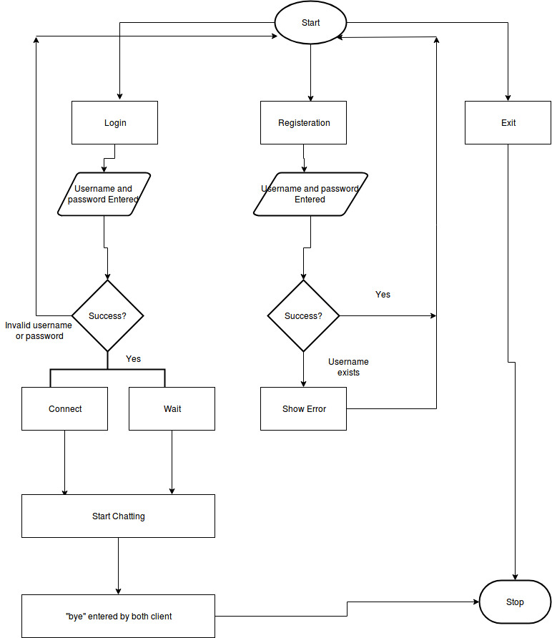
Architecture Diagram

Slide 6
Performance
Type of Load Generator :-
1. Registration:- In this request, the client establishes the connection with Server and do registration operation with user id and password. On completion of the request, Server gives response message.
2. Login :-In this request, client login with credentials and ask for a self-port number from the server. then client creates a socket on self-port number wait for a client request

Slide 7
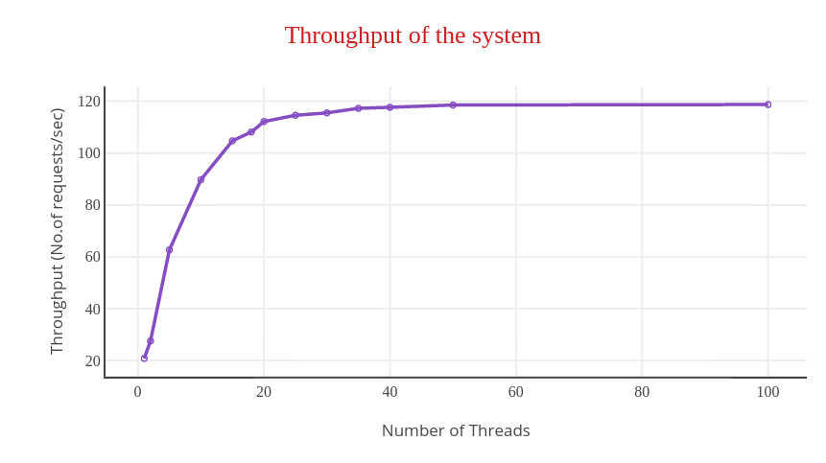
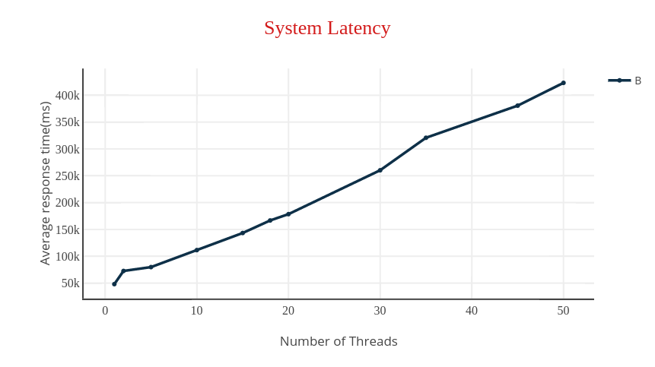

Slide 8
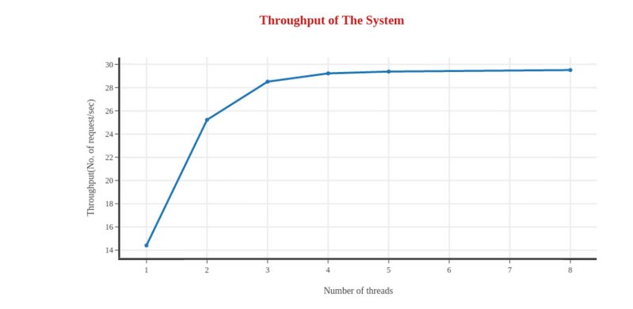
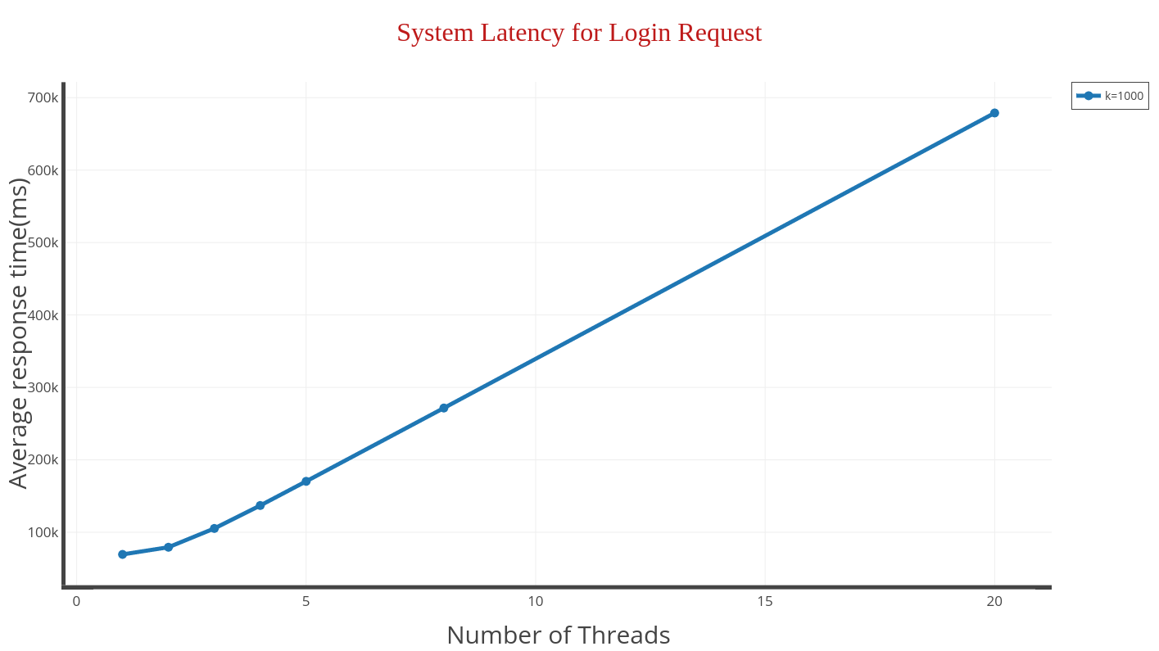

Slide 9
Optimization Approach
Phase 2 Bottleneck
Our system saturated because of full CPU utilization.MYSQL Database was using around 80% of CPU.
Replacing MYSQL database with REDIS
Thread memory deallocation

Slide 10
Comparison
N | Previous Throughput | New Throughput |  | Previous Latency (microsec) | New Latency (microsec)
2 | 27.54 | 140.93 |  | 72585 | 14135
5 | 62.65 | 249.84 |  | 79763 | 19958
10 | 89.72 | 340.36 |  | 111472 | 26371
15 | 104.71 | 368.54 |  | 143315 | 40635
20 | 112.11 | 407.89 |  | 178480 | 48974
25 | 114.54 | 457.27 |  | 260227 | 54623
35 | 117.23 | 493.13 |  | 320779 | 70939
50 | 118.50 | 531.86 |  | 423090 | 93993
In phase 3 , our system is bottlenecked by network.

Slide 11
Conclusion
In this Project ,
Developed a client server system which are connected by TCP socket.
Designed Multi-threaded Multi-tier server.
Learned how to design closed loop load generator.
How to identify the bottleneck of the system.
How to overcome on bottleneck and optimize the system.
Using NOSQL database like REDIS optimize the system .

